Slide 1
Bike Share Prediction

Slide 2
Objective:
Development of a predictive model for predicting bike sharing. The model will determine how many bikes shared by customers (casual and registered both).
Benefits:
Prediction of total bike sharing.
Gives better insight of customers base.
Helps in easy flow for managing resources.

Slide 3
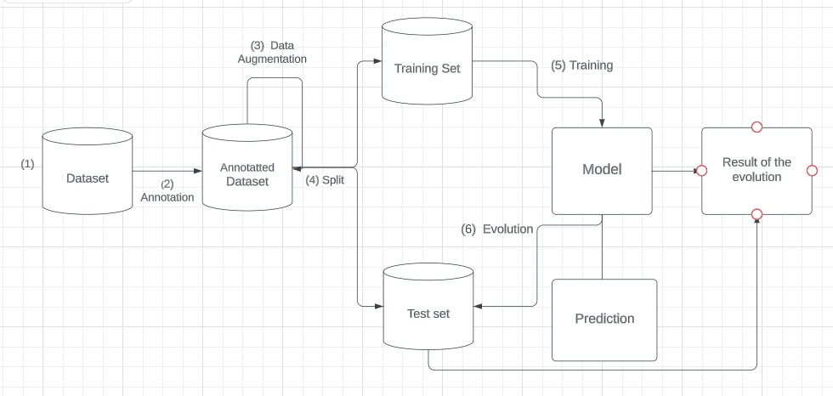
Architecture

Slide 4
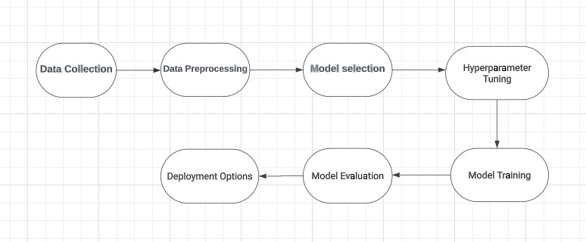
Project Flow

Slide 5
Data Validation and Data Transformation :
Name of Columns - The name of the columns is validated and should be the same as given in the schema file.
Data type of columns - The data type of columns is given in the schema file. It is validated when we insert the files into Database.
Null values in columns - If any of the columns in a file have all the values as NULL or missing, we do feature engineering.

Slide 6
Model Training:
Data Export from csv file :
The accumulated is exported in csv format for model training
Data Preprocessing
Performing EDA to get insight of data like identifying distribution , outliers ,trend
among data etc.
Check for null values in the columns. If present impute the null values.
Encode the categorical values with numeric values.
Perform Standard Scalar (normalization based on given dataset) to scale down the values.

Slide 7
Gradient Boosting Regressor –
Gradient Boosting Regressor is a powerful machine learning algorithm used for regression tasks. It belongs to the family of ensemble methods, which combine multiple weak learners (in this case, decision trees) to create a strong predictive model. The key idea behind gradient boosting is to iteratively improve the model by fitting new trees to the residuals (the differences between the predicted values and the actual target values) of the previous trees.
Model Selection –
we find the best model. By using Grid Search CV. We calculate the r2 scores for models and select the model with the best score.

Slide 8
Prediction:
The testing files are shared in the batches and we perform the same Validation operations ,data transformation and data insertion on them.
The accumulated data is exported in csv format for prediction
We perform data pre-processing techniques on it.
Gradient Boosting Regressor model created during training.
Based on the inputs respective model is loaded and is used to predict the data for that cluster.

Slide 9
Q & A:
Q1) What’s the source of data?
The data for training is provided by the company like mybike , yulu ,oho etc.
Q 2) What was the type of data?
The data was the combination of numerical and Categorical values.
Q 3) What’s the complete flow you followed in this Project?
Refer slide 4th for better Understanding
Q 4) How logs are managed?
We are using different logs as per the steps that we follow in validation and
modeling like File validation log , Data Insertion ,Model Training log , prediction log
etc.

Slide 10
Q 5) What techniques were you using for data pre-processing?
Removing unwanted attributes
Visualizing relation of independent variables with each other and output variables
Checking and changing Distribution of continuous values
Removing outliers
Cleaning data and imputing if null values are present.
Converting categorical data into numeric values.
Scaling the data

Slide 11
Q 6) How training was done or what models were used?
Here we have used Gradient Boosting Regressor from ensemble technique.
Q 7) How Prediction was done?
First we did testing on test data , and after that we can predict on new data .
Q 8) What are the different stages of deployment?
We deployed it on Heroku with CI/CD Pipelines.

Slide 12
Thank you

